Slide 1

Generating multi-jet events with MadGraph
Yoshitaro Takaesu (Sokendai)

Slide 2
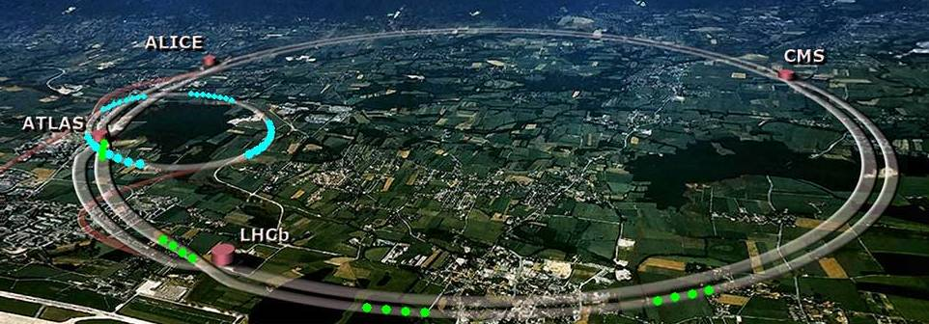
LHC is running
New Physics ?
8 TeV
5 fb^-1
Higgs ?

Slide 3
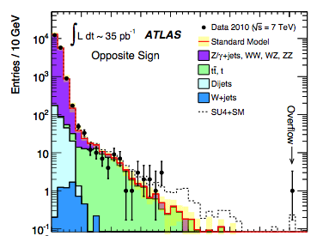
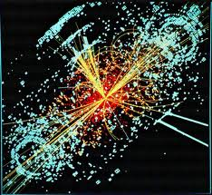
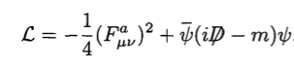

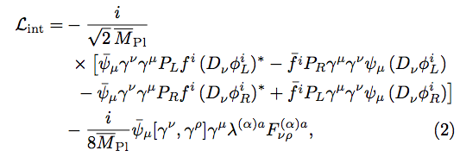
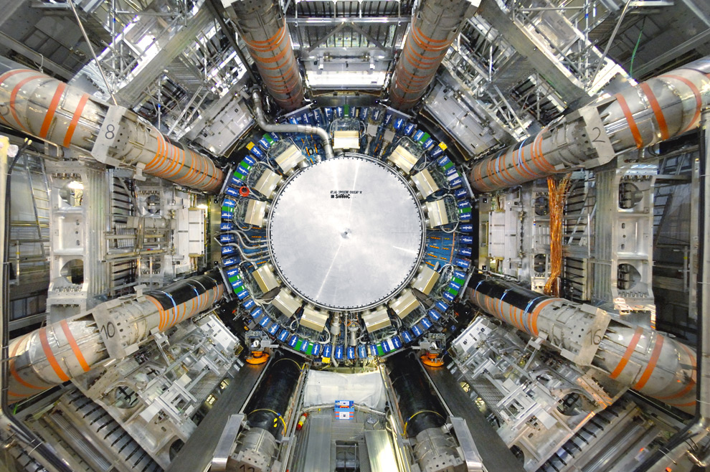
Simulation is an important tool
Simulation
Experiment
Theory

Slide 4
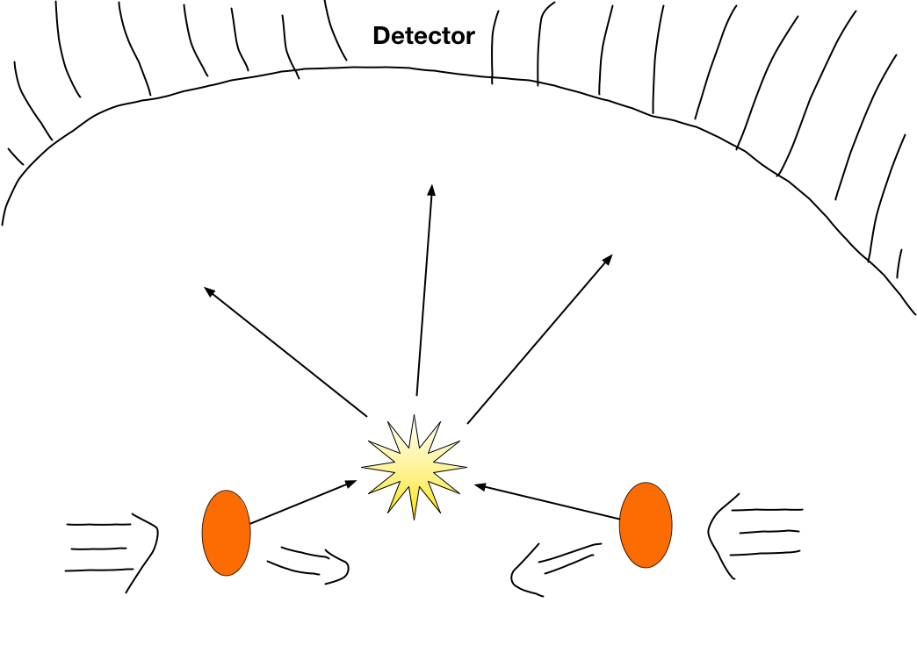
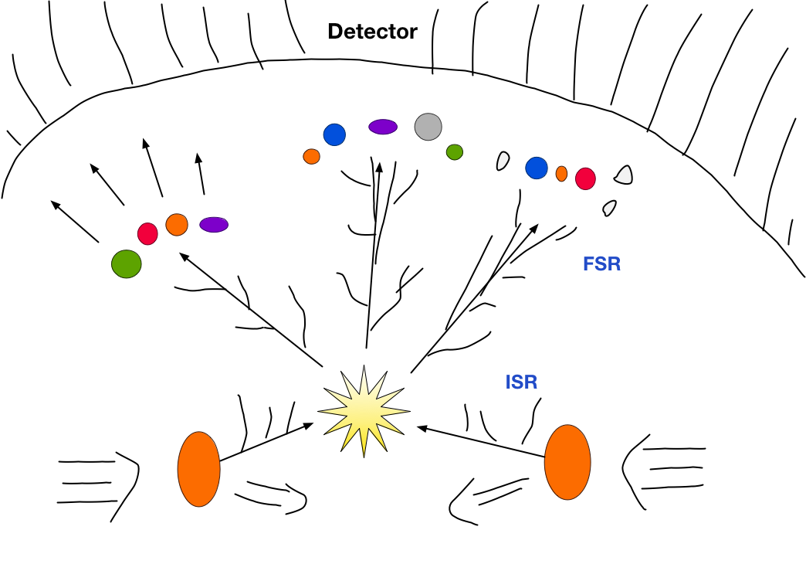
Simulation tools for HEP
Event generator
Simulate high energy collisions of elementary particles ( generating momenta and helicities )
1 Collision-Scattering = 1 Event
Matrix element generator:
Hard scattering (LO, NLO)
A few final state particles
Alpgen, HELAC, Sherpa, MadGraph
Parton shower generator:
Soft/Collinear radiations
Many particles
PYTHIA, Sherpa, Herwig

Slide 5
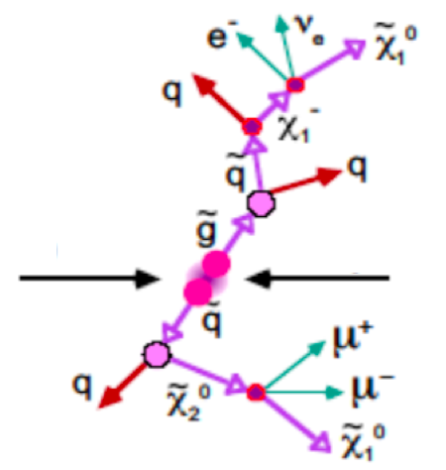
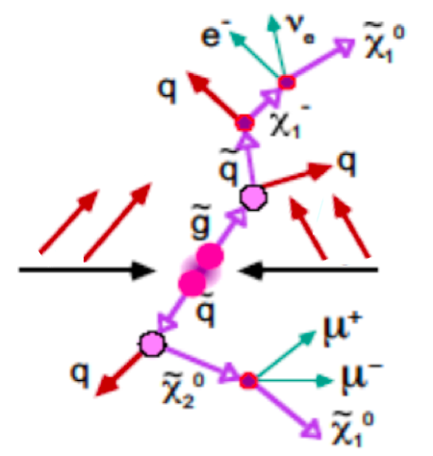
Importance of multi-jet simulation
Multi-jet signature appears in many
New Physics (BSM) models.
need to simulate more hard jets.
need to simulate more jets with
a matrix element generator.
Matrix element generator should be able to generate > 4 jets.

Slide 6
Status of ME generators
Model | Alpgen | HELAC | Sherpa | MadGraph
SM | 6 jets | 10 jets ? | 7 jets | 4 jets
MSSM | ✕ | ？ | 5 jets | 4 jets
Others | ✕ | ✕ | 5 jets | 4 jets
There is no ME generator which can simulate New Physics with > 5 jets.
We would like to extend the ability of HEP simulations
for LHC physics.

Slide 7
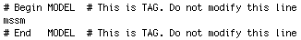
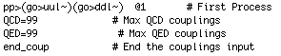
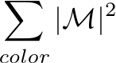
What is MadGraph?
Matrix Element Event Generator
Input
Model + process
Amplitude generator (“MadGraph”)
Feynman diagrams + Fortran codes for
テキスト
Event generator (MadEvent)
Output
Unweighted events in LHE format
MadGraph
7

Slide 8
Usefull features of MadGraph
Many new-physics models
MSSM, MSSM with gravitino, Randall-Sundram, ADD, 2HDM...
FeynRules/ALOHA: new physics implementation by users
Capable of dealing with n-point vertices (higher dim. operators)
Interface to
Parton Shower software (PYTHIA)
Detector simulators ( PGS, Delphes)
Data analysing tools (MadAnalysis, ROOT)
Automated NLO calculation (aMC@NLO)
Simulation of spin-3/2 and spin-2 particles
MadGraph is a powerful simulation tool
for new physics search at the LHC

Slide 9
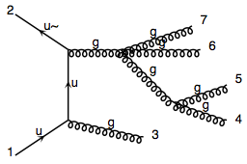
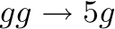
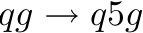
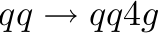
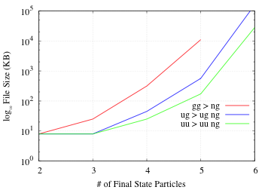
Limitation of MG
Generated Codes (> 8MB) cannot be compiled in usual PC.
The file size of codes for QCD processes
8 MB
Divide the Huge code into small pieces.

Slide 10
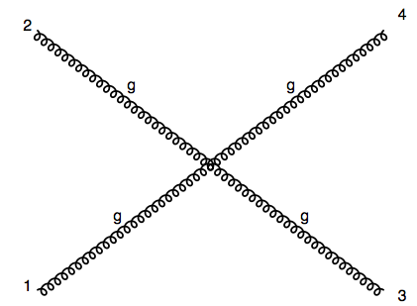
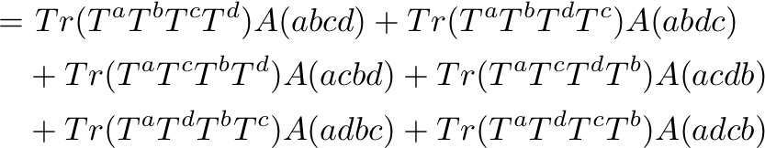
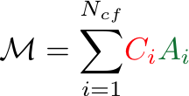
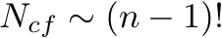
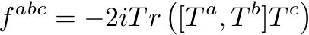
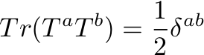
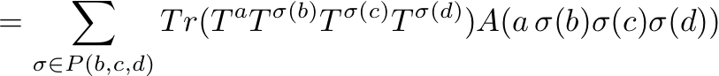
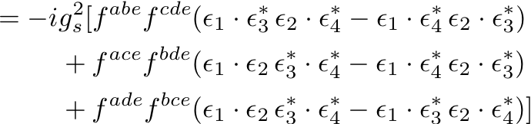
Color decomposition
color-ordered amp.
Color flow
Color Factor
i: Color flow

Slide 11
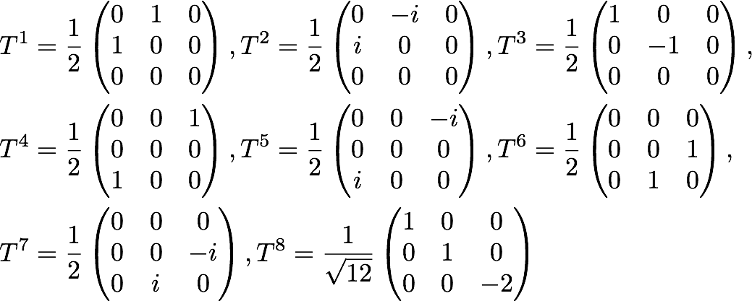
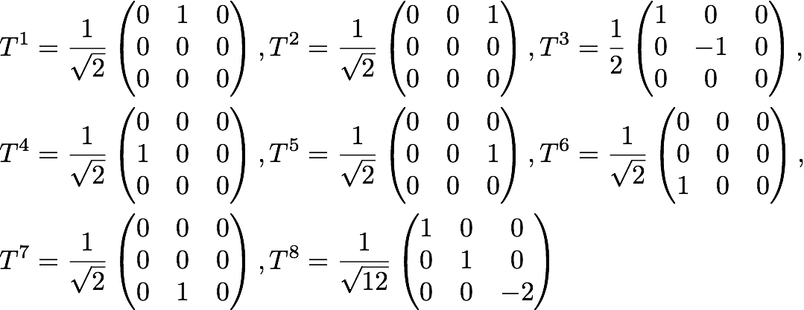
In color decomposition, we usually use Gell-Man matrices or modified matrices for .
Gell-Man:
Modified:

Slide 12
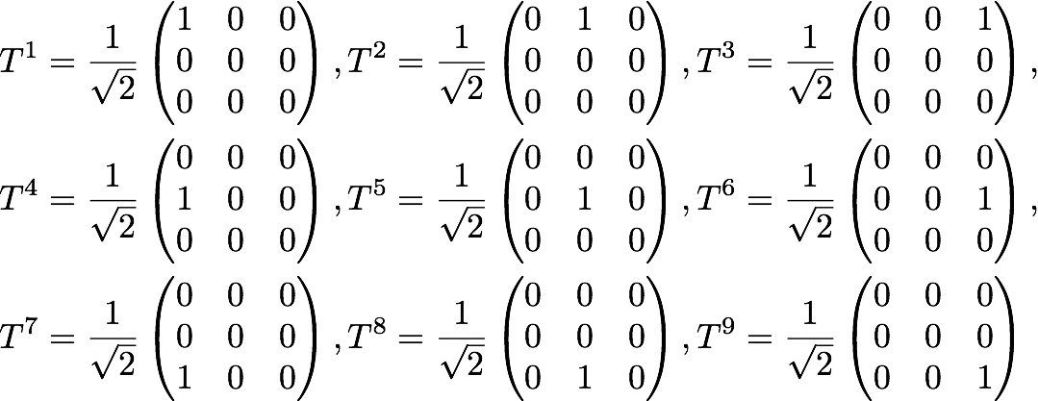
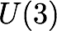
Color-Flow decomposition uses another set of matrices for .
Here are the generators of .
By using this basis, we can simplify the color factors as much as we can: 0 or 1.

Slide 13
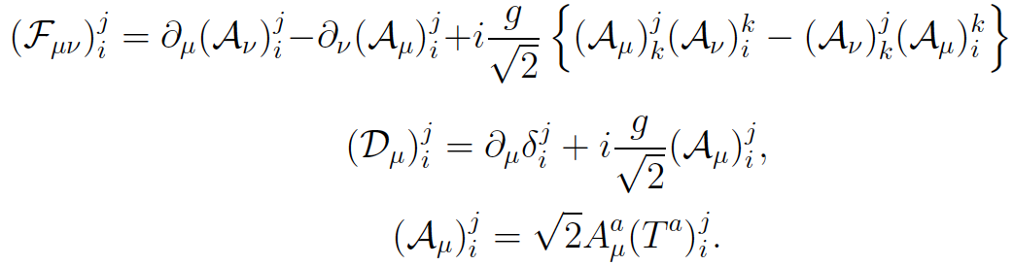
Color-Flow basis
QCD Lagrangian can be written as
13

Slide 14
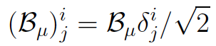
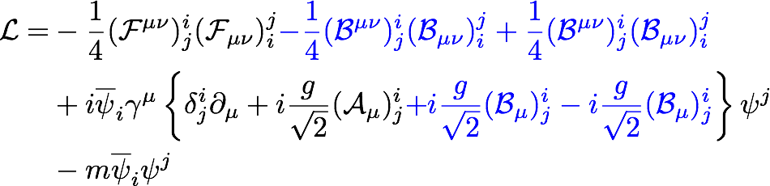
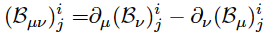
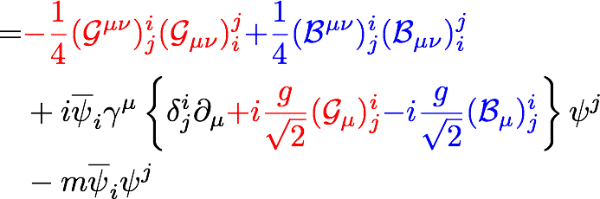
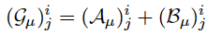
We rewrite this by introducing a U(1) gauge boson
14

Slide 15
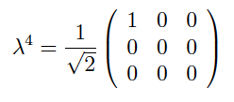
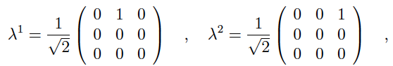
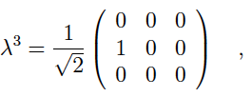
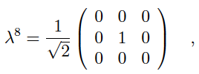
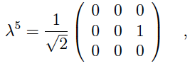
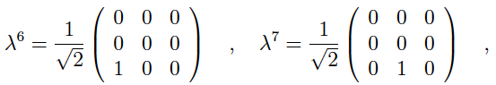
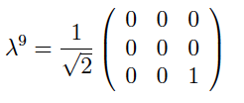
9 U(3) gluons are independent and their
generator matrices are
There is also the abelian gluon in this theory.
The color of a gluon can be expressed by a set of color indeces: (i, j).
15

Slide 16
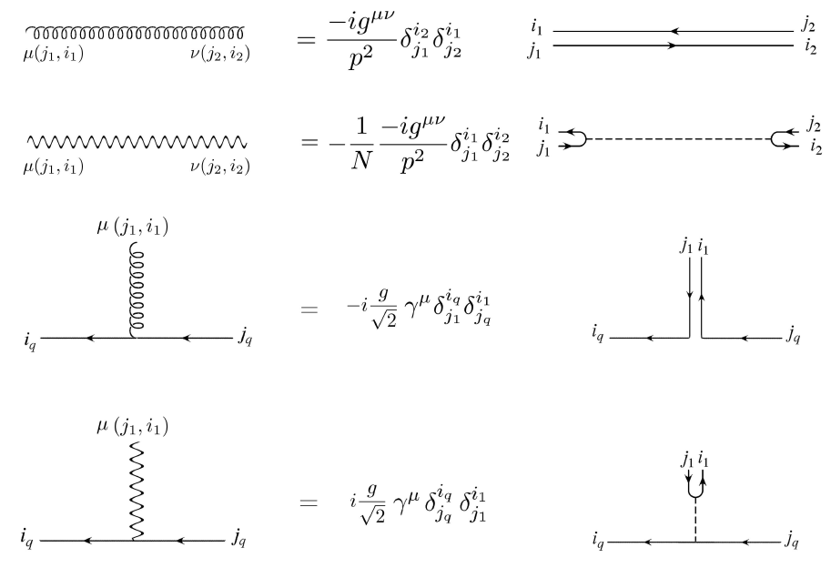
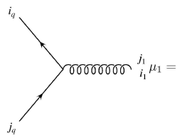
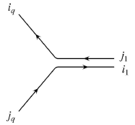
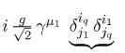
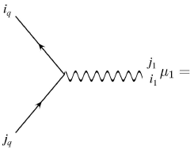
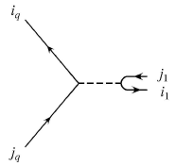
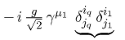
Feynman Rules 1
Color Flow diagrams
Color Flow
16

Slide 17

Feynman Rules 2
The abelian gluon is decoupled from U(3) gluons.
17

Slide 18


From these rules, we evaluate a color-fixed scattering amplitude.
n-gluon amplitude
color factor: 0 or1
partial amplitude
: (n-1)! non-cyclic permutaions
For n-gluon case, are the same as
the Color-Ordered ones.
This is the color-flow decomposition of a n-gluon amplitude.

Slide 19








1 quark line and
amplitude
We add abelian gluon amplitudes to the U(3) gluon ones.
e.g.)

Slide 20














2 quark lines and
amplitude
There are other contributions from propagating abelian gluons
e.g.)

Slide 21




Divide MadGraph code for
Color Factor
color-ordered amp.
divide
Combine them later …

Slide 22




Advantages of dividing code by
Each code for is compilable.
are related to each other by gluon permutations.
do not have to generate all A’s.
are gauge invariant.
We can simplify color-ordered amps
Off-shell recursive relations

Slide 23



Efficient amplitude evaluation
Off-shell recursive relations in fixed color-order

Slide 24










Off-shell recursive relations for gluonic subamplitude
Reduce the # of diagrams and code size
Straightforwardly applicable to New Physics processes

Slide 25

Time performance of recursively generated
color-ordered amplitudes
gg -> ng process
Average of all color-orderd amps
Recursive amp gains from 4 gluons
about 2 ~ 8 factor in execution time
So far we can generate and evaluate
color-ordered amplitudes for multi-jet processes

Slide 26

Re-combine color-ordered amps
Polynomial of Nc:
Huge for multi-jet processes
1/Nc expansion ( SU(Nc))
We do not need
Approximate the color summation
by truncating the expansion.
Reducing the burden of the color summation
with keeping its uncertainty under-controlled.

Slide 27

Multi-jet event generation
✪ Event generation is done with almost the same way to evaluate total cross sections …
1 phase space point -> 1 Event
Generate events with Leading Color Approximation
For each event, include higher order corrections into its weight.

Slide 28



Leading color summation
( ~ 40,000 for gg -> 7g )
Too LARGE
Color-flow sampling
・ Sample color flows to perform color flow summation
・ A phase space point is generated at the same time
・ A color-ordered amp are evaluated for each color flow
Event is a set of momenta, helicities and a color flow

Slide 29

Higher order corrections
For each event with a color flow
Specify needed color flows for the higher order corrections
Evaluate higher order corrections for the phase space point and reweight
Re-unweight

Slide 30

Specify needed color flows
O(1/Nc^2) order correction
Needed color flows are determined systematically.
Needed color flows: obtained from the color flow of the event by a displacement or an exchange of gluons.
displacement
The color flow of a LO event
exchange

Slide 31
Include higher order corrections
We evaluate above expression and multiply it
to the LO event weight to update event weights.
Re-unweight
We unweight events with updated weights with hit & miss method.
Finally, we obtain unweighted events
with higher order corrections.

Slide 32
3. Results

Slide 33




Total cross sections

Slide 34




Distributions (preliminary)

Slide 35
Conclusion
We proposed a method to generate multi-jet events with MadGraph.
Implemented gluonic off-shell recursive relations and generate color-ordered amps.
Generated LO events by sampling color flows
Included higher order corrections
Shown results for gluonic processes for LO event generation.
MadGraph will be able to generate multi-jet events.

Slide 36


Leading order event generation
QCD cross section:
Leading order
Event generation with MG (modified):
Color sum + Multi-channel (diagram channel)
+ Channel improvement (VEGAS)
+ Weighted events + Unweighting ( hit & miss)

Slide 37
LO color summation
Color-flow summation (sampling)
( ~ 40,000 for gg -> 7g )
・ Sampling color flows leads to LO color summation
・ A phase space point is generated at the same time
・ A color-ordered amp are evaluated for each color flow

Slide 38
Higher order corrections
For each event with a color flow
Specify needed color flows for the higher order corrections
Evaluate higher order corrections for the phase space point and reweight
Re-unweight

Slide 39
Specify needed color flows
O(1/Nc^2) order correction
Needed color flows are determined systematically.
Needed color flows: obtained from the color flow of the event by a displacement or an exchange of gluons.
displacement
The color flow of a LO event
exchange

Slide 40
Include higher order corrections
We evaluate above expression and multiply it
to the LO event weight to update event weights.
Re-unweight
We unweight events with updated weights with hit & miss method.
Finally, we obtain unweighted events
with higher order corrections.

Slide 41


Multi-channel phase space integration
D_i : Feynman diagram amplitudes
N_d: # of Feynman diagrams
N_ch : # of channels used
g_i : channel ( phase space parameterization )
The total integral is divided into independent N_ch channel integrals.
Integrand ( inside {…}) have the same peaks as the diagram D_j .
g_i is taken to map these peaks efficiently.
Diagrams used in channels are subset of all diagrams.

Slide 42


Channel diagrams
Evaluation of channel diagrams at each phase space point
is also heavy task for multi-jet processes
We have to reduce them (sacrificing efficiency, but not much )
Channel diagrams:
MG ignore diagrams with 4-point vertices
We also ignore diagrams obtained from
others by gluon permutations
Channel diagrams can be
significantly reduced.
Phase space points are generated according to the basic channels
and choosing gluon permutations randomly.

Slide 43

Event generation with MG (modified):
Color sum + Multi-channel (diagram channel)
+ Channel improvement (VEGAS)
+ Weighted events + Unweighting ( hit & miss)
Channel improvement
Distribution of generated phase space points is tuned to map peaks efficiently, using grids.
Weighted event generation
According to the optimized distribution, events are generated and recorded with evaluated integrand values (weights).
Unweighting
Weighted events are accepted or rejected according to their weight with hit & miss method.
More events for peak region in phase space

Slide 44



Make use of symmetries of color-ordered amps
・Color-ordered amplitudes are related to each other by gluon permutations
color factor
Color-ordered amplitude
: (n-1)! non-cyclic permutations
: SU(3) generators
: momenta and helicities of gluons
Actually we only need to generate some of them.
Other amps are obtained by gluon permutations, using the same code.

Slide 45

・
color factor
partial amplitude
: (n-1)! non-cyclic permutaions
: SU(3) generators
: momenta and helicitys of gluons
are
・gauge invariant
・invariant under cyclic permuations of 1,2, ..., n
・

Slide 46


ex)

Slide 47


ex)

Slide 48
From these rules, we evaluate a color-fixed scattering amplitude.
n-gluon amplitude
color factor: 0 or1
partial amplitude
: (n-1)! non-cyclic permutaions
For n-gluon case, are the same as
the Color-Ordered ones.
This is the color-flow decomposition of a n-gluon amplitude.

Slide 49
1 quark line and
amplitude
We add abelian gluon amplitudes to the U(3) gluon ones.
e.g.)

Slide 50
2 quark lines and
amplitude
There are other contributions from propagating abelian gluons
e.g.)

